Slide 1
Monolithic Architecture
Monolithic architecture is similar to a big container ( one single spring boot project e.g.) that clubs all application components together into a single unit.

Slide 2
Monolithic Architecture
A monolithic application is built as a single unit. Enterprise applications are built in three parts:
A database — consisting of many tables usually in a relational database management system
A client-side user interface — consisting of HTML pages and/or JavaScript running in a browser)
A server-side application — which will handle HTTP requests, execute domain-specific logic, retrieve and update data from the database, and populate the HTML views to be sent to the browser.
This is what makes an architecture monolith — it is a single logical executable. To make any changes to the system, a developer must build and deploy an updated version of the server-side application.

Slide 3
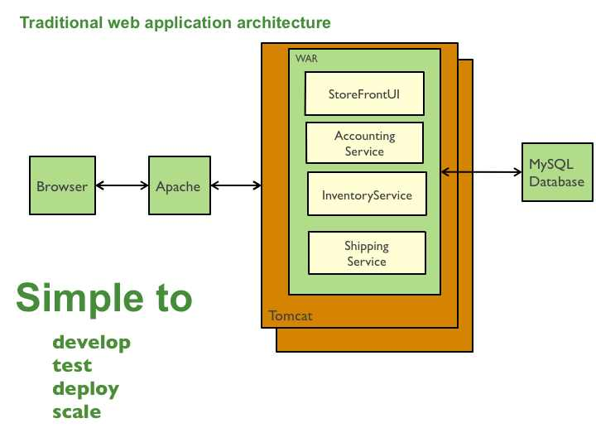

Slide 4
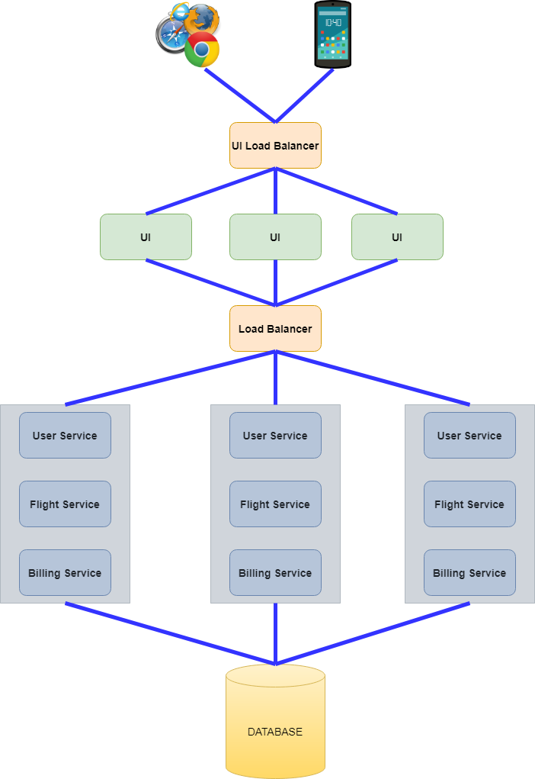

Slide 5
The key feature of “Monolithic Architecture” is the fact that everything (User Service, Flight Service, and Billing Service e.g.) is located inside a single deliverable (a jar file in case of Spring Boot). These services are tightly coupled ( despite the fact that they have totally different functions) and use the same database.
For scaling purposes, multiple identical deliverable units (.jar files) are deployed. The Load Balancer is responsible for routing requests to deployed monolithic services.

Slide 6
Advantages of Monolithic Architecture
Easy to develop
It’s easy for a small team to rapidly pull together and build an executable app using a monolithic system. This makes monolithic architecture ideal for startups without big software development budgets.
Simple deployment
One executable file or directory makes deployment easier.
Uncomplicated testing and debugging
Because the application is fitted as a single unit and works together , testing and debugging happens quickly and easily from a central logging system.
No network latency
Since modules are running on the same server, communication between them won’t cause network delay.

Slide 7
Drawbacks of Monolithic Architecture
Scalability Issues:
  Difficult to scale specific components independently, as the entire application must be scaled together.
Deployment Challenges:
  Deploying a single, large application can be complex and time-consuming. Any change requires redeploying the entire system.
Tight Coupling:
  Components are tightly integrated, making changes in one area potentially affect many other parts of the system, leading to higher interdependencies.

Slide 8
Drawbacks of Monolithic Architecture
Limited Flexibility:
  Hard to adopt new technologies or frameworks for specific components, as the entire system is usually bound to one tech stack.
[ tech stack means Programming language, framework, database, server etc.]
Slower Development:
  As the codebase grows, it becomes harder to manage, leading to longer development cycles and increased risk of bugs.
Difficulty in Maintaining Large Codebases:
  As the application grows, maintaining and understanding the entire codebase becomes challenging for developers.

Slide 9
Drawbacks of Monolithic Architecture
Risk of Single Point of Failure:
  A failure in one part of the monolith can bring down the entire application, affecting all users and services.
Longer Startup Time:
  The application startup time increases as more modules and features are added, making it slower to boot and deploy.
Testing Complexity:
  Testing individual components or modules can be challenging, as the whole monolithic app often needs to be run during tests.

Slide 10
Microservices
Microservices are the small services that work together. E.g. CartService (one project) and ProductService (another project)
These small services communicate with each other directly using light weight protocol like HTTP.

Slide 11
Microservice Architechture
These modules or projects or components are loosely coupled. Different teams can work on different projects or modules.
Microservice
Customer
Microservice
Shipment
Product
Cart
Microservice
Microservice
Microservice
DB
DB
DB

Slide 12
Advantages of Microservices
It’s possible to change or upgrade each service indivisually rather than upgrading the entire application.
One service may down without impacting others. ( e.g. Ecommerce site , you are able to search various products, compare their prices , perform some other tasks but when you say “add to cart” if it gives you error: service is under maintenance, that means inside entire Ecommerce site other than “Cart” service, everything is running properly.
Different technologies can be used to develop different services. ( e.g. one service in java , other in python etc. These both technologies can communicate with each other using HTTP)
Loosely coupled.

Slide 13
Microservice Architechture
Single Entry Point
Github
service1
API
Gateway
MicroService1
Hystrix
Dashboard
Config
Server
common configurations
User/
Client
service2
MicroService2
service3
MicroService3
All the microservices will be registered here
(Eureka Services Discovery) Service Registry
Eureka
Server

Slide 14
Microservice Architechture explained
In the above diagram suppose Microservice1 works on Product, Microservice2 works on Cart and Microservice3 works on Shipment. So all these are separate modules (projects) run on different servers with different port nos. In oder to access these services we have separate URLs ( service1, service2, service3).
What does API Gateway do?
It creates a single entry point for client or user to access multiple microservices. If API Gateway were not there, client would access each and every microservices on different servers and different port no. API Gateway provides single endpoint , that means client doesn’t know how many services are running in the background. Client should know IP Address and port no. of API Gateway. So what client or user does is , it calls API Gateway which will call individual microservices. In case developer would like to apply authentication , he can apply it at API Gateway.

Slide 15
Microservice Architechture explained
How can we implement API Gateway?
Using Spring Cloud Gateway.
What’s the use of Hystrix Dashboard?
It’s a Fault Tolerance [ entire system does not affect even if one or two of its components fail] library. What it does is, suppose you have 3 services in the backend and if any service gets down , we can handle it using Hystrix Library.
What is Eureka Service Discovery?
It has Eureka server on which all your microservices are registered. This Eureka server itself is a microservice. That also means the microservices will be discovered on Eureka server. The microservices which will be registered on the Eureka Server are called as Eureka Client. For this purpose we have to use Eureka Client Library.

Slide 16
Real life analogies
Microservices - Restaurant with multiple specialized kitchens
Analogy: Imagine a restaurant that offers a variety of dishes, but instead of having one large kitchen preparing everything, it has several specialized kitchens. For example, one kitchen is dedicated to making pasta, another to baking pizzas, another to preparing desserts, and another to making drinks.
Microservices: In this analogy, each specialized kitchen is a microservice. Each kitchen (or microservice) focuses on a small, specific part of the restaurant’s menu. Each kitchen is independent and can be run, maintained, and improved separately, and they all work together to provide the complete meal.
Benefit: Just like you can improve or scale the pizza kitchen without affecting the pasta kitchen, with microservices, you can develop, deploy, and scale each service independently.

Slide 17
Real life analogies
API Gateway as the Waiter at the Restaurant
Waiter (API Gateway) Role:
  The waiter takes the customer's order, communicates with the kitchen (microservices), gathers the results (e.g., the food from different kitchens), and brings everything back to the customer.
  The waiter ensures that the customer gets exactly what they ordered, and if there are any special requests (e.g. preferences), they can pass those along to the kitchens.
  If something goes wrong (e.g., a dish takes too long or there’s an issue with preparation), the waiter can take action by either alerting the customer or adjusting the order as needed.
  Benefit: Customers don’t need to know which kitchen prepares which dish—they just interact with the host. Similarly, with the API Gateway, clients don’t need to interact with each microservice directly.

Slide 18
Real life analogies
Hystrix Dashboard - Kitchen Performance Monitor
Analogy: Imagine the restaurant manager has a performance monitor that tracks the cooking speed, order accuracy, and performance of each kitchen. If one kitchen starts getting overwhelmed (e.g., the pizza kitchen is taking too long), the manager can quickly see it on the monitor, take action (e.g., allocate more resources), and prevent customers from being affected by the delay.
Hystrix Dashboard: The Hystrix Dashboard is like this monitor that tracks the health of each microservice (or kitchen). It shows metrics such as the time taken to process requests, errors, and failures. If one microservice is failing or underperforming, the dashboard helps to visualize that, allowing engineers to intervene before it impacts users.
Benefit: By monitoring the performance of each service (kitchen), you can quickly detect problems and take corrective action, ensuring the customer experience remains smooth.

Slide 19
Real life analogies
Eureka Server - Restaurant Directory or Reservation System
Eureka Server (Restaurant Directory) keeps track of all available branches (microservices).
"Branch 1: Pizza kitchen at Location A (open)"
"Branch 2: Pasta kitchen at Location B (open)"
"Branch 3: Dessert kitchen at Location C (closed for maintenance)"
"Branch 4: Pizza kitchen at Location D (open)"
A customer (client) requests a meal (API request).
The waiter (API Gateway) asks the Eureka Server (restaurant directory) which kitchen (microservice) is available for pizza.
Eureka responds: "Branch 1: Pizza kitchen at Location A" and "Branch 4: Pizza kitchen at Location D" are both open and can
handle the order.
The waiter then directs the customer to one of the available kitchens (microservices).

Slide 20
How do Microservices communicate with each other
HTTP
Microservice1
Microservice2
REST JSON

Slide 21
Companies using microservices
Few organizations such as Netflix, PayPal, Amazon, eBay, and Twitter are currently using microservices.

